Slide 1

Hotel Reception Desk Application
Efficient Room Management and Guest Services with Akka, Kafka, and Play Framework
-PRIYANSHI CHOUHAN
19th November 2024

Slide 2
Problem Statement
Create an application to automate and streamline Hotel Reception Managent processes.

Slide 3
Key Features of the Application
Real-time room availability tracking for smooth check-ins and check-outs.
Secure guest booking management and ID proof storage.
Automated email notifications for Room Service, WiFi Service, and Restaurant Service.
Daily menu updates to guests during their stay.
Microservice architecture with asynchronous messaging.

Slide 4
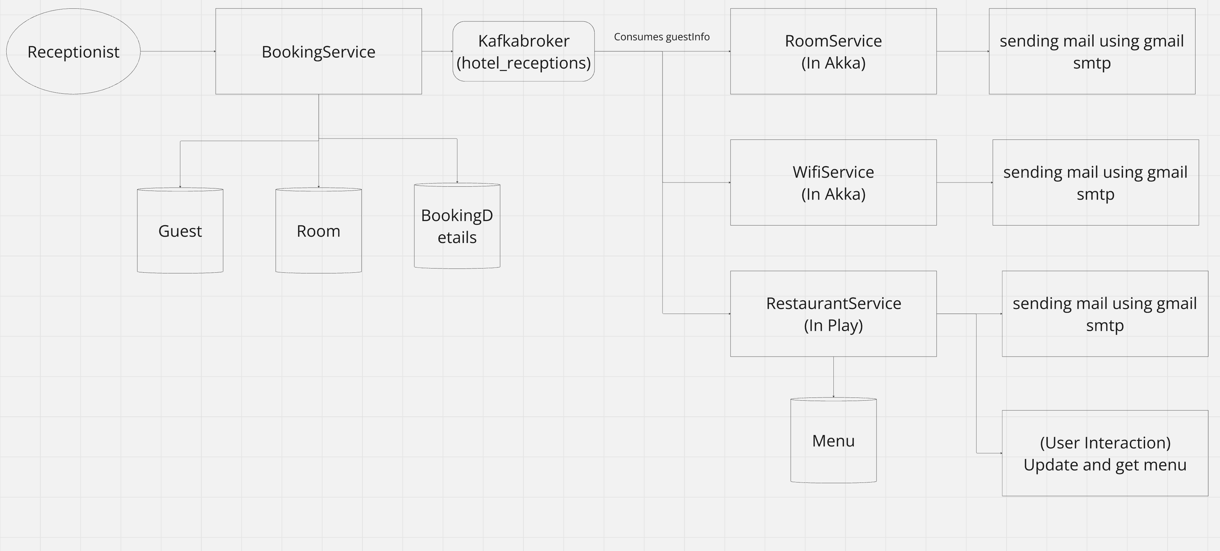
System Architecture

Slide 5
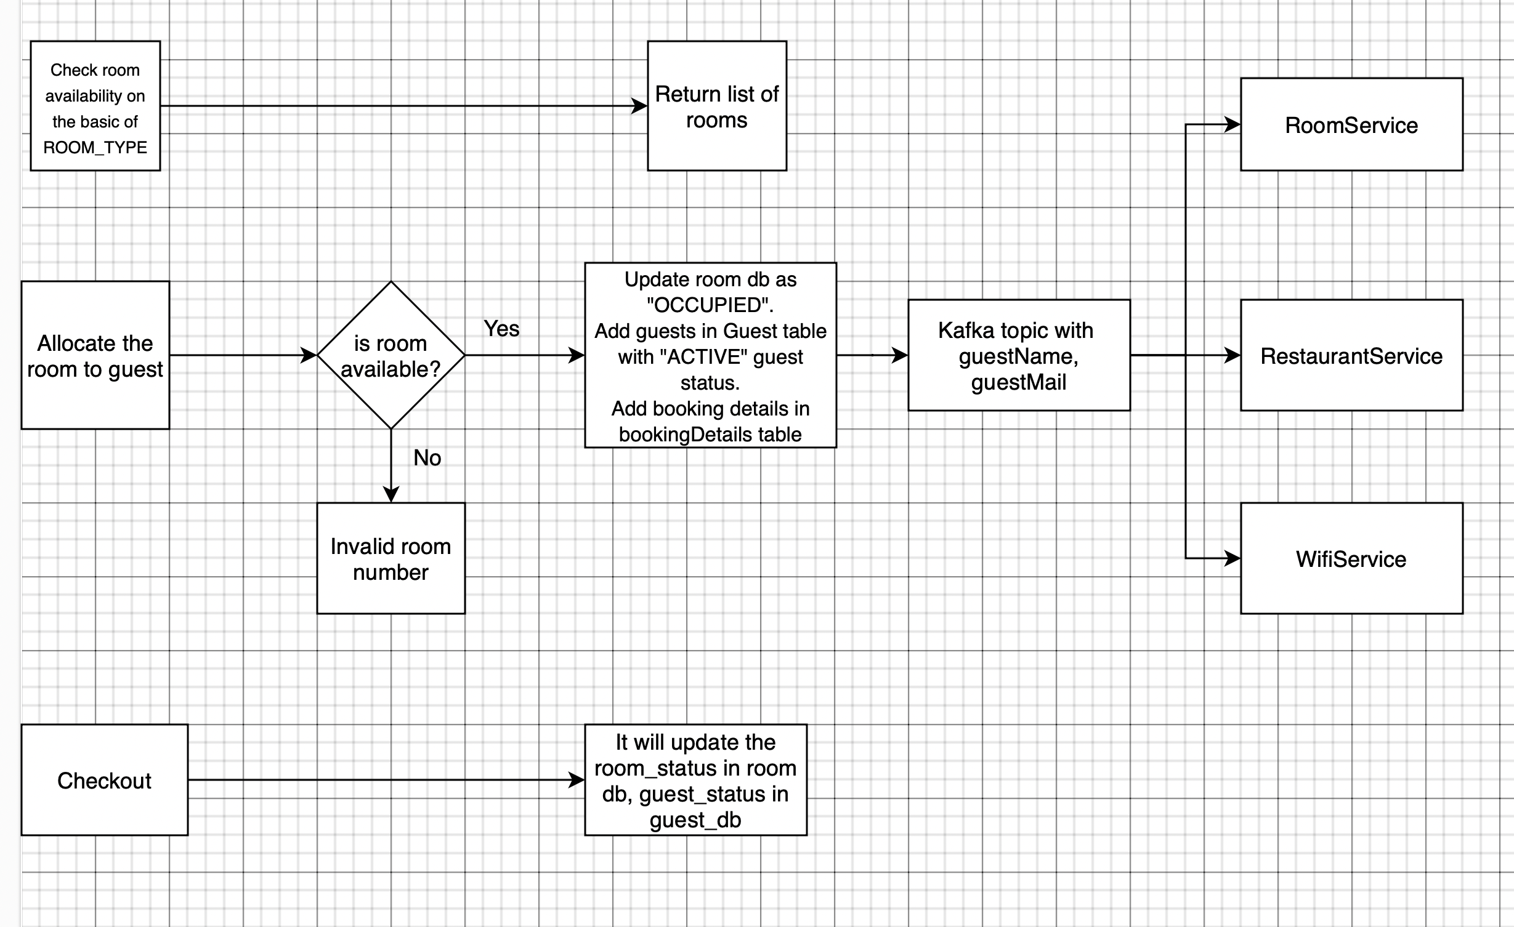
Functional Workflow

Slide 6
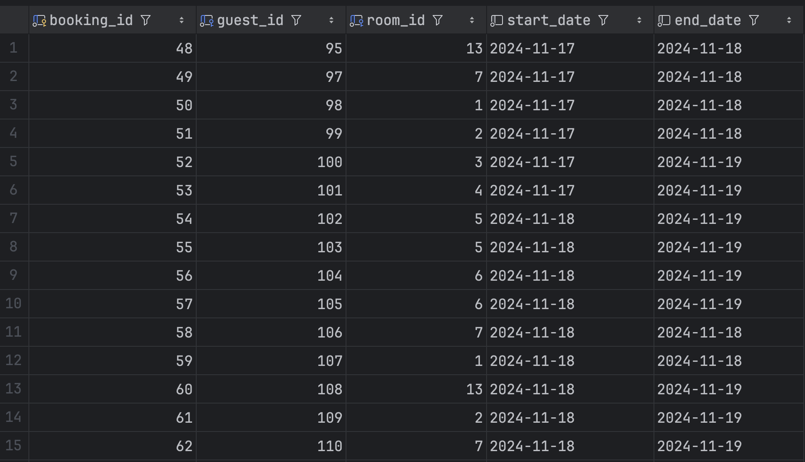
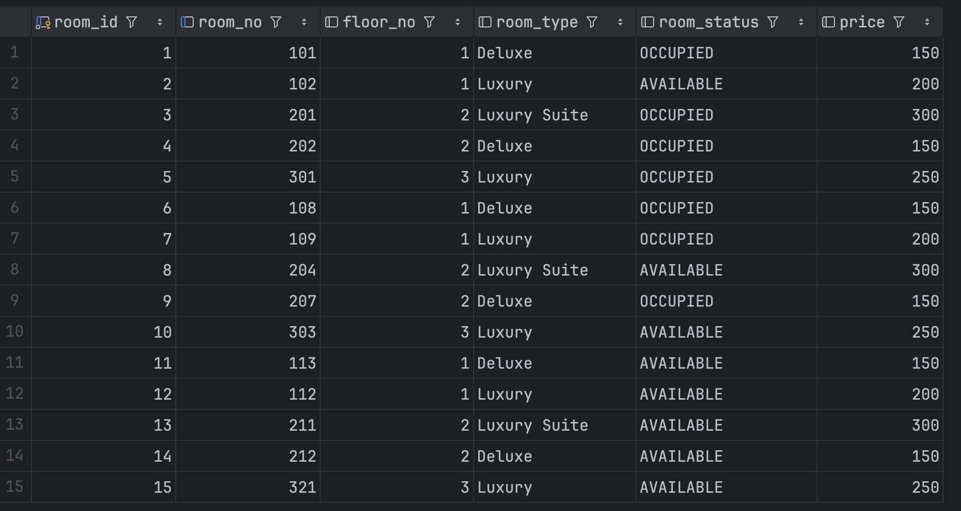
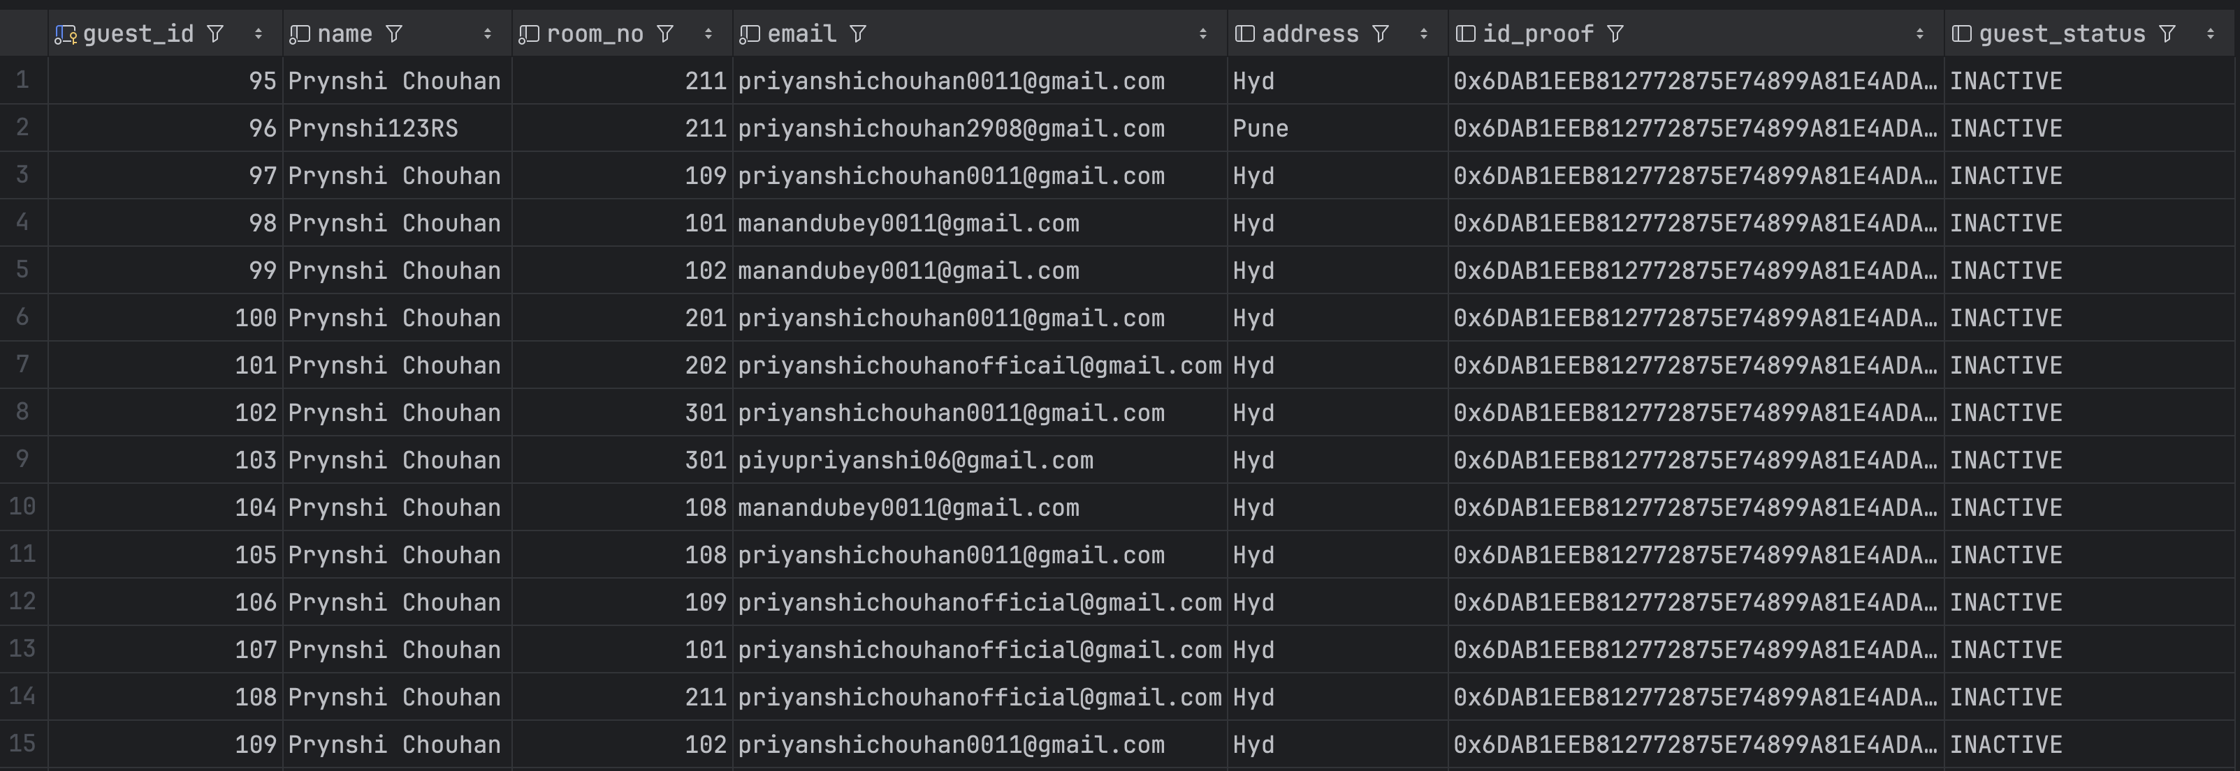
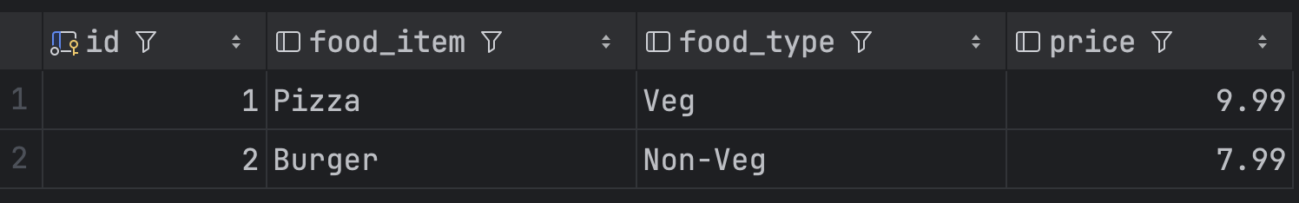
.

Slide 7




